Slide 1
Good disagreement?
Grace and Truth in a Divided Church

Slide 2
I-it versus i-thou
This language is the brainchild of German Jewish theologian Martin Buber. He proposes that when we are not intentional, most of our interactions, even with God, are I-It (or Subject-Object) interactions. Far more desirable and satisfying are I-Thou (Subject-Subject) relationships.
Can you think of a time where an I-It relationship in your life transformed into I-Thou? How did this happen?

Slide 3
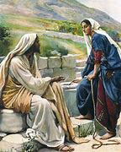
Nuptial imagery
The author presents Jesus’ encounter with the Samaritan woman at the well in John 4 as a “nuptial moment,” one in which God, through Christ, extends a marriage proposal to one of God’s creatures.
What do you believe are the strengths of this nuptial imagery in terms of our spiritual life?

Slide 4
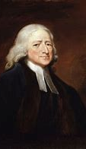
A key nuptial moment: john wesley
The author asserts that the rise of Methodism and John Wesley in particular are great exemplars of the sort of peacemaking moments he is extolling.
Early Methodism included women’s voices to an astounding degree in its historical/cultural context. How do Wesley’s arguments in favor of this inform our interpretation of Scripture?

Slide 5
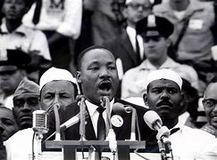
A radical assertion
The author asserts that the charismatic Pentecostal movement of the 1970s was more powerful than any other force in engendering racial reconciliation.
Do you agree with this assertion? If so, what are the implications for our own day?

Slide 6
Another radical assertion
“We are no longer a church at war with others, even though our commitment to orthodoxy is stronger and our standards of holiness are higher than during our days of division.”
What do you make of such a statement? What are its implications for a church such as St. Bart’s?

Slide 7
What are we to do?
With whom are we now called by God to have a peacemaking/nuptial moment?
Our local ACNA church (St. Francis of Assisi)?
The Roman Catholic Church?
Protestant Evangelicals, e.g. Celebration Church?
Other religions, e.g. Jews, Muslims, Hindus, Jain?
Certain sectors of the secular world?
How do we go about this work?

