Slide 1
Good disagreement?
Grace and Truth in a Divided Church

Slide 2
Reconciliation: what is it?
Reconciliation is a change in status. Reconciled parties go from being enemies to being friends, from being “far off” to being “brought near.”
So then, remember that at one time you Gentiles by birth, called ‘the uncircumcision’ by those who are called ‘the circumcision’—a physical circumcision made in the flesh by human hands— remember that you were at that time without Christ, being aliens from the commonwealth of Israel, and strangers to the covenants of promise, having no hope and without God in the world. But now in Christ Jesus you who once were far off have been brought near by the blood of Christ. For he is our peace; in his flesh he has made both groups into one and has broken down the dividing wall, that is, the hostility between us. He has abolished the law with its commandments and ordinances, so that he might create in himself one new humanity in place of the two, thus making peace, and might reconcile both groups to God in one body through the cross, thus putting to death that hostility through it. So he came and proclaimed peace to you who were far off and peace to those who were near; for through him both of us have access in one Spirit to the Father. So then you are no longer strangers and aliens, but you are citizens with the saints and also members of the household of God.
Ephesians 2:11-19

Slide 3
How important is reconciliation?
The word and idea of reconciliation doesn’t appear that often in the Bible.
Nonetheless, it is arguably utterly central in Christian theology:
From now on, therefore, we regard no one from a human point of view; even though we once knew Christ from a human point of view, we know him no longer in that way. So if anyone is in Christ, there is a new creation: everything old has passed away; see, everything has become new! All this is from God, who reconciled us to himself through Christ, and has given us the ministry of reconciliation; that is, in Christ God was reconciling the world to himself, not counting their trespasses against them, and entrusting the message of reconciliation to us. So we are ambassadors for Christ, since God is making his appeal through us; we entreat you on behalf of Christ, be reconciled to God.
2 Corinthians 5:16-20

Slide 4
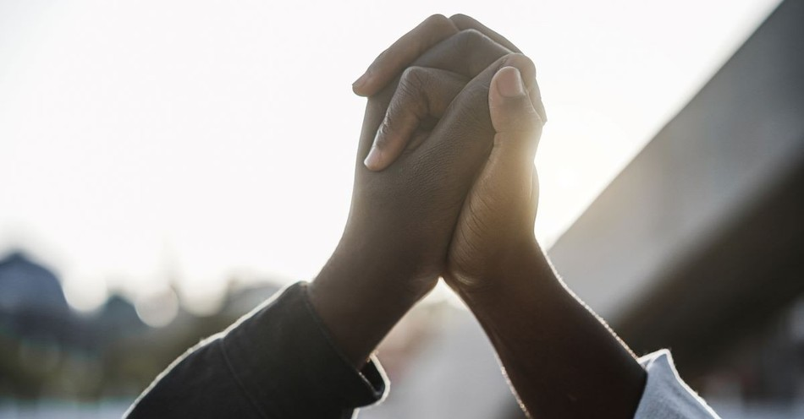
What is unique about new testament reconciliation?
Usually the party that initiates reconciliation is the offending party.
In the New Testament, however, it is God (the offended party) who initiates it and who bears the heavy cost.
What implications does this have for Christ’s faithful?

Slide 5
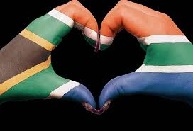
All things in proper order
Reconciliation is not simply a human matter, and it is definitely not simply the end of conflict.
We must first be reconciled to God, and only then and from that state can we be reconciled as a human family.
Do we put up obstacles to being reconciled to God? What are they?

Slide 6
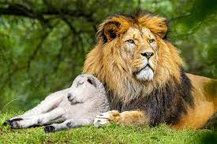
A cosmic matter
Reconciliation is not simply a matter of us individually being restored to friendship with God. It involves the entire cosmos:
The wolf shall live with the lamb, the leopard shall lie down with the kid, the calf and the lion and the fatling together, and a little child shall lead them. The cow and the bear shall graze, their young shall lie down together; and the lion shall eat straw like the ox. The nursing child shall play over the hole of the asp, and the weaned child shall put its hand on the adder’s den. They will not hurt or destroy on all my holy mountain; for the earth will be full of the knowledge of the Lord as the waters cover the sea.
Isaiah 11:6-9

Slide 7
A key to mission and evangelism
We promise at our Baptism “to proclaim by word and example the Good News of God in Christ.”
This Good News must include the reconciliation of humanity to our Creator.
The only tool we have for proclaiming the Good News of reconciliation to the world is to show ourselves to be a reconciled family.
How do we do this and make it highly visible to the world?

Slide 8
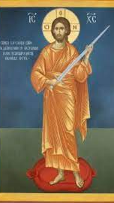
A paradox
Reconciliation goes hand-in-hand with division:
‘Do not think that I have come to bring peace to the earth; I have not come to bring peace, but a sword. For I have come to set a man against his father, and a daughter against her mother, and a daughter-in-law against her mother-in-law; and one’s foes will be members of one’s own household.
Matthew 10:34-36

Slide 9
Good disagreement on the biggest issue?
God’s act of reconciliation in Christ creates division between those who can accept a unified and reconciled creation and those who cannot.
Is it possible to have Good Disagreement even across this barrier, in other words to practice tolerance of spirit even with those who, by all appearances, favor division and conflict?

