Slide 1
Good disagreement?
Grace and Truth in a Divided Church

Slide 2
What is good disagreement?
Not the absence of conflict
Conflict conducted in a way that strengthens rather than weakening the bonds of love between conflicting parties.

Slide 3
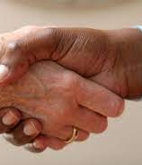
Basic ground rule for this class
This class is meant to be not only an academic exploration of Good Disagreement but an opportunity to practice it.
Each of us will very likely disagree with some of the texts we read.
Each of us will very likely disagree with some of the things other participants say.
Let us prayerfully endeavor to transform these moments into Good Disagreement.

Slide 4
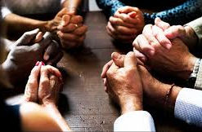
Examples of good disagreement?
Can you think of an example of Good Disagreement…
…from the Bible?
…from your everyday life?

Slide 5
One of the first disagreements in the church
Now the apostles and the believers who were in Judea heard that the Gentiles had also accepted the word of God. So when Peter went up to Jerusalem, the circumcised believers criticized him, saying, ‘Why did you go to uncircumcised men and eat with them?’ Then Peter began to explain it to them, step by step, saying, ‘I was in the city of Joppa praying, and in a trance I saw a vision. There was something like a large sheet coming down from heaven, being lowered by its four corners; and it came close to me. As I looked at it closely I saw four-footed animals, beasts of prey, reptiles, and birds of the air. I also heard a voice saying to me, “Get up, Peter; kill and eat.” But I replied, “By no means, Lord; for nothing profane or unclean has ever entered my mouth.” But a second time the voice answered from heaven, “What God has made clean, you must not call profane.” This happened three times; then everything was pulled up again to heaven. At that very moment three men, sent to me from Caesarea, arrived at the house where we were. The Spirit told me to go with them and not to make a distinction between them and us. These six brothers also accompanied me, and we entered the man’s house. He told us how he had seen the angel standing in his house and saying, “Send to Joppa and bring Simon, who is called Peter; he will give you a message by which you and your entire household will be saved.” And as I began to speak, the Holy Spirit fell upon them just as it had upon us at the beginning. And I remembered the word of the Lord, how he had said, “John baptized with water, but you will be baptized with the Holy Spirit.” If then God gave them the same gift that he gave us when we believed in the Lord Jesus Christ, who was I that I could hinder God?’ When they heard this, they were silenced. And they praised God, saying, ‘Then God has given even to the Gentiles the repentance that leads to life.’
Acts 11:1-18

Slide 6
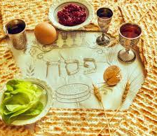
A big controversy in the early church
Was it necessary for converts to the Christian faith to keep kosher and observe Jewish tradition?
Did this end up being a Good Disagreement? How so?

Slide 7
Three simple but challenging principles
In the life of the Church…
…truth matters.
…grace matters.
…when disagreements arise, we cannot dispense with either.

Slide 8
A key distinction
There is more than one kind of tolerance:
Tolerance of mind (accepting all ideas and viewpoints as valid and equal)
Tolerance of spirit (accepting all persons as valid and deserving of grace and dignity)
The Christian life insists that we always practice tolerance of spirit but not always tolerance of mind.

Slide 9
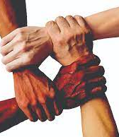
How do we do it?
How do we practice both grace and truth, in other words always exhibiting tolerance of spirit but not always tolerance of mind?
At least in our current context people often assume that if their ideas are being confronted, their whole being is under attack. What are some good techniques for diffusing this?

Slide 10
Truth has gradations
It can be helpful to divide truths into three categories:
The essentials (truths for which we’re not just willing but obligated to enter into conflict)
The desirable but non-essentials
The relatively unimportant
How do we accurately distinguish truths?

