Slide 1
Good disagreement?
Grace and Truth in a Divided Church

Slide 2
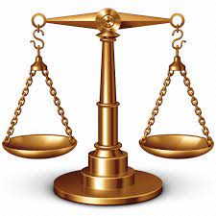
The authority of scripture
Two extremes:
God speaks primarily through my own experience (and perhaps current cultural trends). Scripture has no significant authority except perhaps to be a poetic backdrop for our conversations.
Scripture is the sole authority and can be interpreted only in the plain sense of the text. All questions are summarily settled in terms of what “the Bible says.”

Slide 3
The authority of scripture
Let’s pick an issue of contemporary importance.
How can we wrestle with this issue in a way that is faithful to the authority of Scripture and is sensitive to context and people’s experiences?

Slide 4
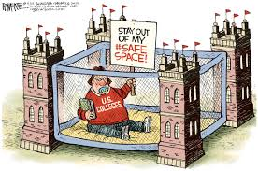
A safe space?
The authors seem to be generating a genuinely safe space in their discourse: one in which each intentionally welcomes the other to express ideas they find bizarre or even repugnant and to respond to such ideas with curiosity and friendly debate.
Such a space isn’t “safe” by the modern secular definition at all. It is a place where we are constantly being challenged and kept off balance. To what extent is today’s church called to be a safe space in this sense? What are the boundaries on this?

Slide 5
A safe space?
Church is called to be a safe space in both senses, and it is a very difficult balance to strike:
Provide comfort for the gathered people, i.e. affirm their faith and beliefs, or at least assure them that God loves them exactly as they are.
Challenge God’s people by placing them in close personal relationships, relationships that must be grounded in love, with those who espouse deeply conflicting propositions (how would you feel for example if we invited each of this chapter’s authors to preach on her beliefs about the role of women in church and family?).
How do you wish to see our church strike this balance?

Slide 6
A safe space?
Are there ways in which you don’t find the space safe for yourself and your beliefs
At St. Bart’s?
In our Diocese?
In the wider Church?
In Livermore?
In our nation/the world?
What do you believe is the best course of action based on your answers?

Slide 7
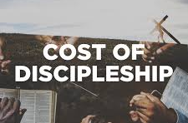
The heavy cost of good disagreement
The authors point out that Good Disagreement can be very costly. Sometimes it results in everyone on both sides of a heated debate turning against us. Are you willing to share examples of where your attempts at Good Disagreement have come at a cost in terms of relationships, respect, material wealth, and perhaps even personal safety?
What spiritual tools do you find helpful in such moments?

