Slide 1
Good disagreement?
Grace and Truth in a Divided Church

Slide 2
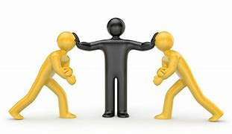
Jesus christ the mediator
For there is one God; there is also one mediator between God and humankind, Christ Jesus, himself human, who gave himself a ransom for all.
1 Timothy 2:5-6
But Jesus has now obtained a more excellent ministry, and to that degree he is the mediator of a better covenant, which has been enacted through better promises.
Hebrews 8:6

Slide 3
Reflections on mediation
What were your overall impressions of the chapter?
Where/when is mediation a fitting way to handle conflict? Where/when is it not?

Slide 4
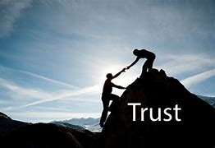
Trust: a key element
For mediation to work, both parties must trust the mediator, knowing full well that the mediator may not be fully, or at all, “on their side.”
This certainly jibes with the image of Christ as mediator-both God and humanity must trust Him with such an important mission.
How can trust be built in a climate where disagreement is often equated with untrustworthiness?

Slide 5
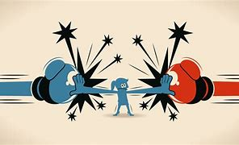
Where might we benefit?
Are there issues in our current life as church (locally, at the Diocesan level, or more globally) where we might benefit from mediation?
How do you envision this playing out?

Slide 6
Final reflections
We have spent ten weeks looking at Good Disagreement from many angles and listening to/reading many voices.
What are you taking away from this conversation?
Does anything feel more settled?
Does anything feel less settled?
What does this leave you wondering?

