Slide 1
Good disagreement?
Grace and Truth in a Divided Church

Slide 2
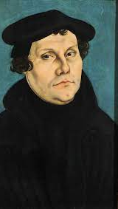
A deep dive into reformation history
Chapter 5 explores Reformation history in depth, focusing especially on Germany, Switzerland, and England.
There were unquestionably many incidents of bad disagreement during and after the Reformation. Were there, however, also moments of Good Disagreement?

Slide 3
At issue between the reformers and traditional catholics
How does salvation occur?
By grace/faith alone?
By responding to God by acts of love and good works?
What sources of authority are valid in the Christian life?
The Bible alone?
Monastic/liturgical tradition?
Recognized leaders of the Church, e.g. Pope, Bishops, and Priests?

Slide 4
At issue amongst the protestant reformers
What is the nature of the Lord’s Supper?
The actual physical Body and Blood of Christ (transubstantiation)?
A spiritual but nonetheless very real Presence of Christ?
Simply a memorial supper?
What is the main source of unity amongst Christians?
Worship/liturgy?
The Bible? And if the Bible do we insist that we practice only what is directly stated in Scripture, or do we allow “all things not repugnant to Scripture?”
Doctrine?
Behavior/acts of charity?

Slide 5
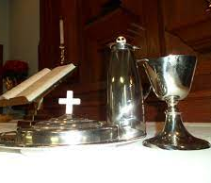
Where do we stand?
What does salvation mean, and how does it happen?
What is the authority of Scripture?
What is the nature of the Lord’s Supper?
What are the sources of Christian unity?

Slide 6
How do we foster unity and good disagreement?
We focus on the essentials and lovingly embrace diversity when it comes to the adiaphora?
But how do we determine the essentials and the adiaphora?
What are your essentials? Your adiaphora?

Slide 7
The times, they are a-changing
Example: the ordination of women
In the not-too-distant past this was seen as an essential, and the mainline Protestant Church agreed that it was unbiblical.
For a season it has been treated as adiaphora.
It is now once again treated as essential, but now the Church insists that it must be practiced everywhere.
Are there other examples of similar patterns? How do we discern when it is the Spirit at work transforming our sense of what is essential?

Slide 8
The times, they are a-changing
In what ways could the Reformation be said to be an example of Good Disagreement?
Are there opportunities for Good Disagreement in today’s debates over what is essential and how far we are willing to go to enforce unity?

